Slide 1
LOGISTICS OPTIMIZATION USING SQL
DATA ANALYSIS & PERFORMANCE INSIGHTS ON LOGISTICS OPERATIONS
NAME: HARIKA CHAMARTHI
COURSE: INTERNSHALA DATA SCIENCE PLACEMENT PROGRAM

Slide 2
TASK 1: DATA CLEANING & PREPARATION
Checked for duplicate Order_ID records
Handled missing traffic delay values
Verified date format consistency
Identified invalid delivery dates
Ensured data quality before performing further analysis.

Slide 3
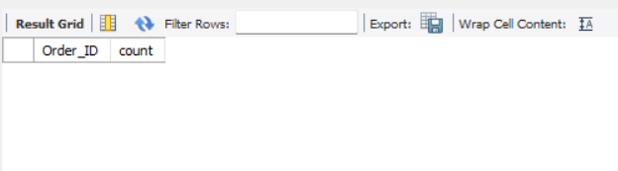
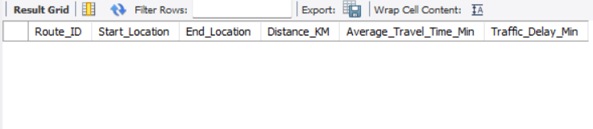
DUPLICATE & MISSING DATA HANDLING
Identify duplicate Order_ID records
SELECT Order_ID , COUNT(*) AS count
FROM orders
GROUP BY Order_ID
HAVING COUNT(*) > 1;
2. Check for NULL Traffic_Delay_Min values
SELECT *
FROM routes
WHERE Traffic_Delay_Min is NULL;
No duplicate or missing values were found, indicating high data quality.

Slide 4
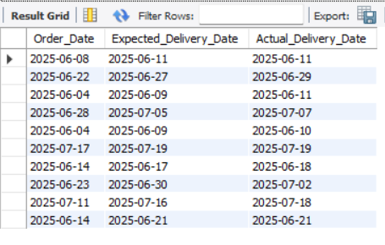
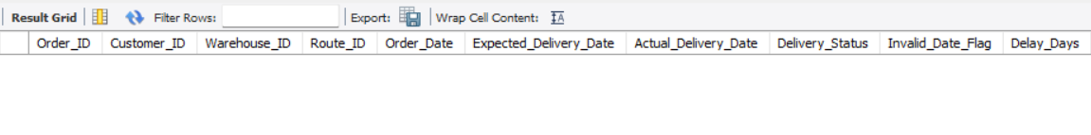
DATE VALIDATION & ERROR HANDLING
• Date Format Validation
SELECT Order_Date, Expected_Delivery_Date, Actual_Delivery_Date
FROM orders;
• Invalid Date Detection
SELECT Order_ID, Order_Date, Actual_Delivery_Date
FROM orders
WHERE Actual_Delivery_Date < Order_Date;
• Invalid Data Flagging
ALTER TABLE orders ADD COLUMN Invalid_Date_Flag VARCHAR(10);
UPDATE orders
SET Invalid_Date_Flag = 'Invalid'
WHERE Actual_Delivery_Date < Order_Date;
No invalid date records were found. All delivery data is consistent.

Slide 5
TASK 2: DELIVERY DELAY ANALYSIS
Calculated delivery delay for each order
Identified top delayed routes
Ranked orders within each warehouse using window functions
Analyzed delivery performance to identify delays and operational inefficiencies.

Slide 6
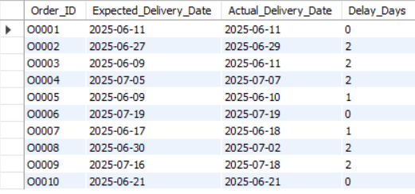
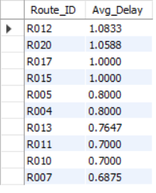
DELIVERY DELAY CALCULATION & ROUTE ANALYSIS
Delay calculation:
SELECT Order_ID, Expected_Delivery_Date, Actual_Delivery_Date, DATEDIFF(Actual_Delivery_Date,
Expected_Delivery_Date) AS Delay_Days FROM orders;
Top delayed routes:
SELECT Route_ID, AVG(Delay_Days) AS Avg_Delay FROM orders GROUP BY Route_ID ORDER BY Avg_Delay DESC;
Certain routes show consistently higher delays, indicating inefficiencies in route planning and execution.

Slide 7
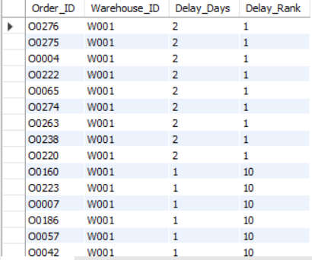
WAREHOUSE-WISE DELAY RANKING
SELECT
Order_ID,
Warehouse_ID,
Delay_Days,
RANK() OVER (
PARTITION BY Warehouse_ID
ORDER BY Delay_Days DESC
) AS Delay_Rank
FROM orders;
Orders are ranked within each warehouse to identify the most delayed shipments and performance gaps.

Slide 8
TASK 3: ROUTE OPTIMIZATION INSIGHTS
Calculated key performance metrics for each route
Identified inefficient routes using efficiency ratio
Analyzed delay percentage across routes
Suggested optimization strategies for improvement
This analysis helps identify inefficient routes and areas for operational improvement.

Slide 9
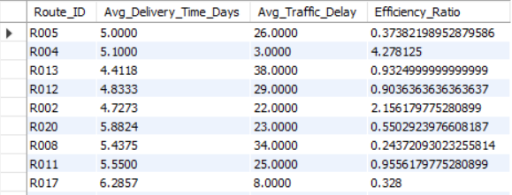
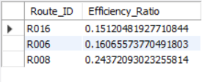
ROUTE PERFORMANCE & EFFICIENCY ANALYSIS
Route metrics:
SELECT o.Route_ID, AVG(DATEDIFF(o.Actual_Delivery_Date, o.Order_Date)) AS Avg_Delivery_Time_Days, AVG(r.Traffic_Delay_Min) AS Avg_Traffic_Delay, (r.Distance_KM / r.Average_Travel_Time_Min) AS Efficiency_Ratio FROM orders o JOIN routes r ON o.Route_ID = r.Route_ID GROUP BY o.Route_ID, r.Distance_KM, r.Average_Travel_Time_Min;
Worst efficiency routes:
SELECT Route_ID, Start_Location, End_Location, (Distance_KM / Average_Travel_Time_Min) AS Efficiency_Ratio FROM routes ORDER BY Efficiency_Ratio ASC LIMIT 3;
Routes with lower efficiency ratio indicate poor distance-to-time performance and require optimization.

Slide 10
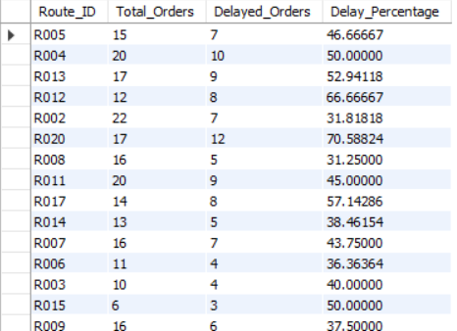
DELAYED ROUTES ANALYSIS & OPTIMIZATION
SELECT
Route_ID,
COUNT(*) AS Total_Orders,
SUM(CASE
WHEN Delay_Days > 0 THEN 1
ELSE 0
END) AS Delayed_Orders,
(SUM(CASE
WHEN Delay_Days > 0 THEN 1
ELSE 0
END) * 100.0 / COUNT(*)) AS Delay_Percentage
FROM orders
GROUP BY Route_ID
HAVING Delay_Percentage > 20;
High-delay routes should be optimized using better path planning
Low efficiency routes require improved travel time strategies
Traffic delays can be reduced using real-time route monitoring
Critical routes should be prioritized for operational improvements

Slide 11
TASK 4: WAREHOUSE PERFORMANCE ANALYSIS
Identified warehouses with highest processing time
Analyzed total vs delayed shipments
Detected bottleneck warehouses using global average
Evaluated warehouse performance using on-time delivery percentage
This analysis highlights warehouse efficiency and identifies operational bottlenecks.

Slide 12
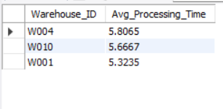
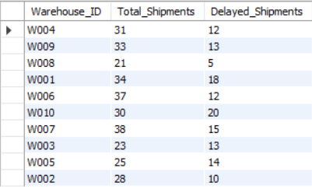
WAREHOUSE PROCESSING & SHIPMENT ANALYSIS
Top 3 warehouses:
SELECT Warehouse_ID, AVG(DATEDIFF(Actual_Delivery_Date, Order_Date)) AS Avg_Processing_Time FROM orders GROUP BY Warehouse_ID ORDER BY Avg_Processing_Time DESC LIMIT 3;
Total vs delayed shipments:
SELECT Warehouse_ID, COUNT(*) AS Total_Shipments, SUM(CASE WHEN Delay_Days > 0 THEN 1 ELSE 0 END) AS Delayed_Shipments FROM orders GROUP BY Warehouse_ID;
Certain warehouses show higher processing times and delayed shipments, indicating operational inefficiencies.

Slide 13

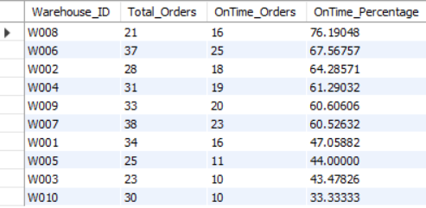
BOTTLENECK WAREHOUSES & PERFORMANCE RANKING
Bottleneck warehouses:
SELECT Warehouse_ID, AVG(DATEDIFF(Actual_Delivery_Date, Order_Date)) AS Avg_Processing_Time FROM orders GROUP BY Warehouse_ID HAVING Avg_Processing_Time > ( SELECT AVG(DATEDIFF(Actual_Delivery_Date, Order_Date)) FROM orders );
On-time ranking:
SELECT Warehouse_ID, COUNT(*) AS Total_Orders, SUM(CASE WHEN Delay_Days <= 0 THEN 1 ELSE 0 END) AS OnTime_Orders, (SUM(CASE WHEN Delay_Days <= 0 THEN 1 ELSE 0 END) * 100.0 / COUNT(*)) AS OnTime_Percentage FROM orders GROUP BY Warehouse_ID ORDER BY OnTime_Percentage DESC;
Warehouses with processing time above the global average are identified as bottlenecks, while ranking highlights top-performing warehouses based on delivery efficiency.

Slide 14
TASK 5: DELIVERY AGENT PERFORMANCE ANALYSIS
Ranked delivery agents based on on-time performance
Identified agents with low delivery efficiency
Compared average speed of top and bottom performing agents
This analysis helps evaluate agent performance and identify improvement opportunities.

Slide 15
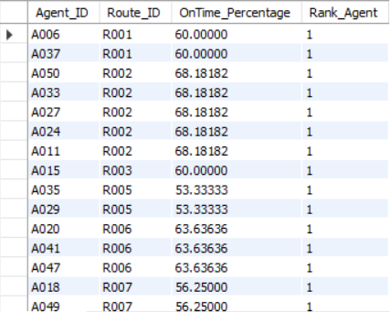
AGENT PERFORMANCE RANKING (ROUTE-WISE)
SELECT
da.Agent_ID,
o.Route_ID,
(SUM(CASE
WHEN o.Delay_Days <= 0 THEN 1
ELSE 0
END) * 100.0 / COUNT(*)) AS OnTime_Percentage,
RANK() OVER (
PARTITION BY o.Route_ID
ORDER BY
(SUM(CASE
WHEN o.Delay_Days <= 0 THEN 1
ELSE 0
END) * 100.0 / COUNT(*)) DESC
) AS Rank_Agent
FROM orders o
JOIN deliveryagents da
ON o.Route_ID = da.Route_ID
GROUP BY da.Agent_ID, o.Route_ID;
Agents are ranked within each route based on on-time delivery performance.
Since many agents have similar performance within the same route, they receive the same rank.

Slide 16
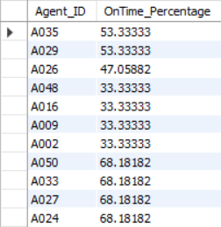

LOW PERFORMING AGENTS & PERFORMANCE COMPARISON
Low-performing agents:
SELECT da.Agent_ID, (SUM(CASE WHEN o.Delay_Days <= 0 THEN 1 ELSE 0 END) * 100.0 / COUNT(*)) AS OnTime_Percentage FROM orders o JOIN deliveryagents da ON o.Route_ID = da.Route_ID GROUP BY da.Agent_ID HAVING OnTime_Percentage < 80;
Speed comparison:
SELECT 'Top 5 Agents' AS Category, AVG(Avg_Speed_KM_HR) AS Avg_Speed FROM ( SELECT Avg_Speed_KM_HR FROM deliveryagents ORDER BY On_Time_Percentage DESC LIMIT 5 ) AS top_agents UNION SELECT 'Bottom 5 Agents', AVG(Avg_Speed_KM_HR) FROM ( SELECT Avg_Speed_KM_HR FROM deliveryagents ORDER BY On_Time_Percentage ASC LIMIT 5 ) AS bottom_agents;
Agents with on-time performance below 80% indicate operational inefficiencies.
The speed comparison shows that higher-performing agents tend to maintain better delivery efficiency, highlighting the importance of both speed and reliability.

Slide 17
TASK 6: SHIPMENT TRACKING ANALYTICS
Track last checkpoint status of shipments
Analyze common delay reasons
Identify orders with multiple delays
This analysis helps monitor shipment progress, identify delay patterns, and detect high-risk deliveries for improved logistics efficiency.

Slide 18
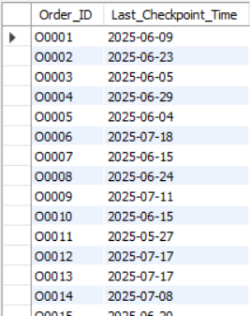
SHIPMENT TRACKING & LAST CHECKPOINT ANALYSIS
Last checkpoint per order
SELECT
Order_ID,
MAX(Checkpoint_Time) AS Last_Checkpoint_Time
FROM shipment
GROUP BY Order_ID;
The latest checkpoint time for each order helps track shipment progress, identify current delivery status, and detect potential delays in transit.

Slide 19
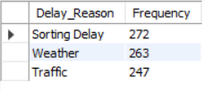
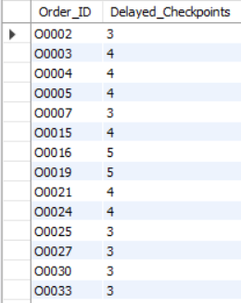
DELAY REASONS & CRITICAL SHIPMENTS ANALYSIS
Most common delay reasons
SELECT
Delay_Reason,
COUNT(*) AS Frequency
FROM shipment
WHERE Delay_Reason IS NOT NULL
AND Delay_Reason <> 'None'
GROUP BY Delay_Reason
ORDER BY Frequency DESC;
Orders with >2 delayed checkpoints
SELECT
Order_ID,
COUNT(*) AS Delayed_Checkpoints
FROM shipment
WHERE Delay_Reason IS NOT NULL
AND Delay_Reason <> 'None'
GROUP BY Order_ID
HAVING COUNT(*) > 2;
Key Insights:
Frequent delay reasons such as sorting delays, weather, and traffic highlight key operational challenges.
Orders with multiple delayed checkpoints indicate high-risk shipments that require immediate monitoring and corrective action.

Slide 20
TASK 7: ADVANCED KPI REPORTING
Measuring key logistics performance indicators to evaluate delivery efficiency and operational performance.
• Analyzed delivery delay across regions
• Calculated overall on-time delivery performance
• Evaluated traffic delays across routes
These KPIs provide a comprehensive view of delivery performance and help identify areas for operational improvement and optimization.

Slide 21
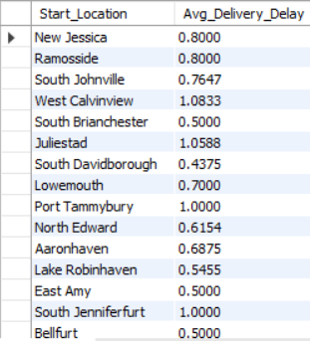

DELIVERY PERFORMANCE KPIs (REGION & OVERALL)
Avg delivery delay per region
SELECT
r.Start_Location,
AVG(o.Delay_Days) AS Avg_Delivery_Delay
FROM orders o
JOIN routes r
ON o.Route_ID = r.Route_ID
GROUP BY r.Start_Location;
Overall on-time delivery %
SELECT
(SUM(CASE
WHEN Delay_Days <= 0 THEN 1
ELSE 0
END) * 100.0 / COUNT(*)) AS OnTime_Percentage
FROM orders;
Regional delay analysis highlights areas with higher delivery delays,
while the overall on-time percentage serves as a key indicator of operational efficiency and service reliability.

Slide 22
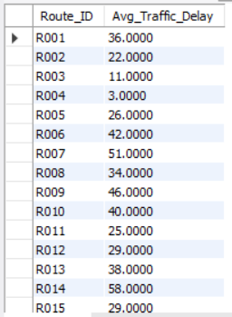
TRAFFIC DELAY & ROUTE PERFORMANCE ANALYSIS
Avg traffic delay per route
SELECT
Route_ID,
AVG(Traffic_Delay_Min) AS Avg_Traffic_Delay
FROM routes
GROUP BY Route_ID;
Average traffic delay per route identifies congestion-heavy routes and enables better route optimization, improving delivery efficiency and reducing delays.

Slide 23
CONCLUSION
Data cleaning ensured accuracy and reliability of analysis
Identified key issues in routes, warehouses, and delivery agents
High delays were mainly caused by traffic and operational inefficiencies
Performance gaps were observed across warehouses and agents
SQL-based analysis helped uncover actionable insights to improve logistics efficiency and delivery performance
VIDEO EXPLANATION LINK:
https://drive.google.com/file/d/1D5JMecWxd0xjv4DMXLXaGnk2Jwn6kNEM/view?usp=sharing

Slide 24
THANK YOU

